Slide 1




Compare NoSQL to SQL

Slide 2

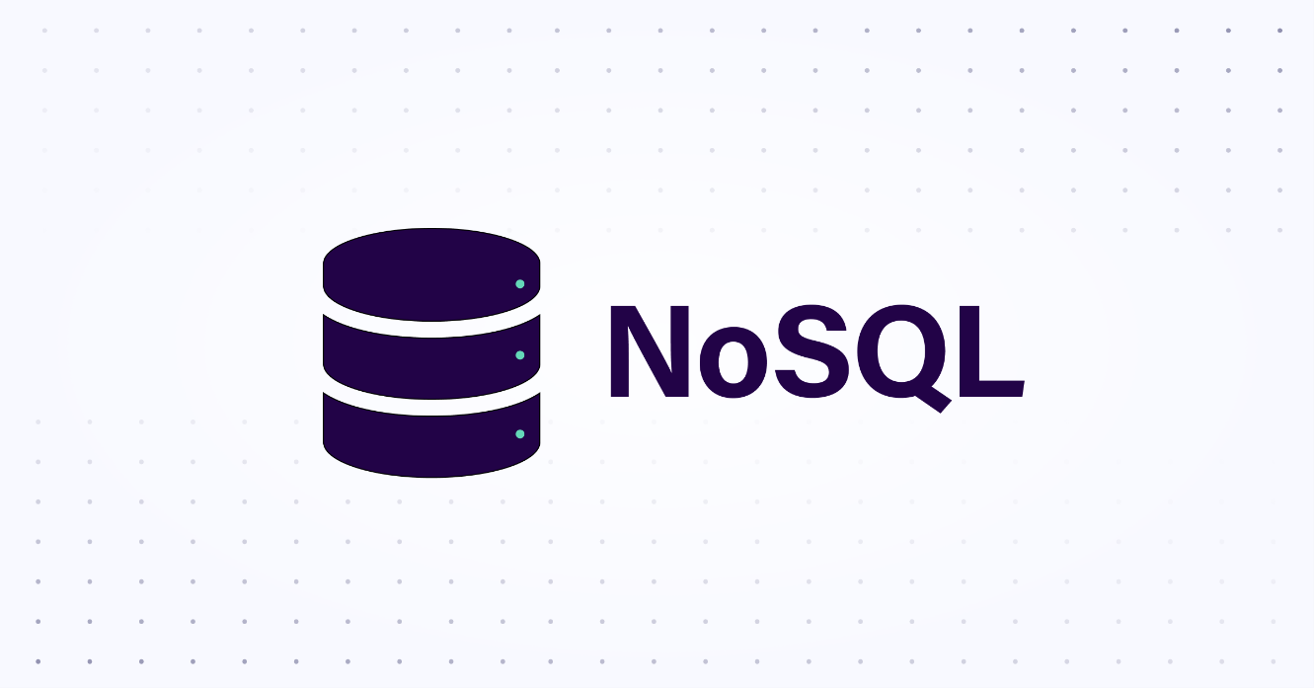
NoSQL Vs SQL
1
2
1. SQL databases are based on the relational data model. They store data in tables with predefined schemas, where each table has columns representing the attributes of the data and rows representing individual records.
2. NoSQL databases use various data models such as key-value, document, columnar, or graph. They provide flexibility by allowing the schema to be dynamic and not enforcing strict relationships between data.

Slide 3
NoSQL Vs SQL
1
2
1. Traditional SQL databases, known as RDBMS (Relational Database Management Systems), are typically vertically scalable. This means that they can handle increased loads by upgrading hardware resources like CPU, RAM, or storage on a single machine.
2. NoSQL databases are designed to be horizontally scalable. They can handle increased workloads by distributing data across multiple servers or clusters, providing high scalability and performance.

Slide 4
NoSQL Vs SQL
1
2
1. SQL databases use the SQL language, which is a standard language for managing and querying relational databases. It provides a rich set of operations for data manipulation, retrieval, and aggregation, including joins, filtering, and grouping.
2. NoSQL databases have their query languages, which vary depending on the database type. Some NoSQL databases support SQL-like query languages, while others provide APIs or specific query languages tailored to the data model used.

Slide 5
NoSQL Vs SQL
1
2
1. SQL databases enforce a rigid schema, where the structure of the data must be defined upfront. Any changes to the schema often require altering table structures, which can be time-consuming and disruptive.
2. NoSQL databases offer schema flexibility. They allow dynamic and unstructured data to be stored without requiring a predefined schema. This flexibility enables agile development and easy adaptation to changing data requirements.

Slide 6
NoSQL Vs SQL
1
2
1. SQL databases are well-suited for applications that require complex transactions, data integrity, and strong consistency. They are commonly used in financial systems, e-commerce platforms, and applications where relational data and ACID (Atomicity, Consistency, Isolation, Durability) properties are crucial.
2. NoSQL databases excel in handling large volumes of unstructured or semi-structured data, high write/read scalability, and distributed environments. They are often used in applications like content management systems, real-time analytics, IoT (Internet of Things) platforms, and social networks.

Slide 7
Research Presentation End
Notes:
You can use this slide as your opening or closing slide. Should you choose to use it as a closing, make sure you review the main points of your presentation. One creative way to do that is by adding animations to the various graphics on a slide. This slide has 4 different graphics, and, when you view the slideshow, you will see that you can click to reveal the next graphic. Similarly, as you review the main topics in your presentation, you may want each point to show up when you are addressing that topic.
Add animation to images and graphics:
Select your image or graphic.
Click on the Animations tab.
Choose from the options. The animation for this slide is “Split”. The drop-down menu in the Animation section gives even more animations you can use.
If you have multiple graphics or images, you will see a number appear next to it that notes the order of the animations.
Note: You will want to choose the animations carefully. You do not want to make your audience dizzy from your presentation.

